Slide 1
CG2271 Real Time Operating Systems
Lab Lecture 4
Timer Programming
(Reference Guide Chapter 29)

Slide 2
Introduction
Lab Lecture 4 – Timer Programming

Slide 3
Introduction
The MCXC444 features three low power Timer/PWM Modules (TPMs).
  TPM0, 1 and 2 can be clocked through various sources.
  Each features a 16-bit counter that can count upwards or downwards.
  Each TPM has 6 external channels that can function as:
    Input capture – count number of times an input is triggered.
    PWM – Phase correct (centre-aligned) or fast (edge-aligned) PWM.
    Compare – Triggered when counter matches a value.

Slide 4
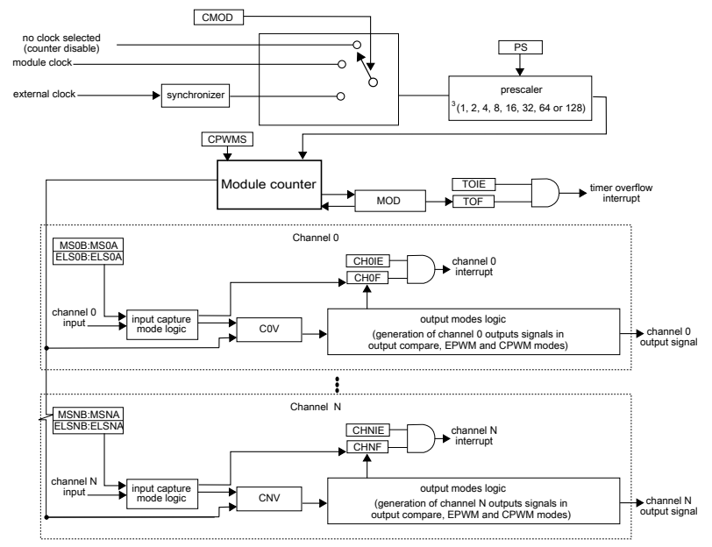
Introduction

Slide 5
Introduction
The TPMs have many features but in this lecture we will only focus on generating interrupts at fixed intervals.
  Useful for timing events (e.g. interval between a GPIO input being triggered), for creating a pre-emptive OS kernel, etc.
In the next lecture we will look at using the TPMs to generate PWM signals.
Once you understand the basics, you can reconfigure the TPMs to do other things.
  E.g. generate waveforms when a value is matched.

Slide 6
Clock source setup
Lab Lecture 4 – Timer Programming

Slide 7
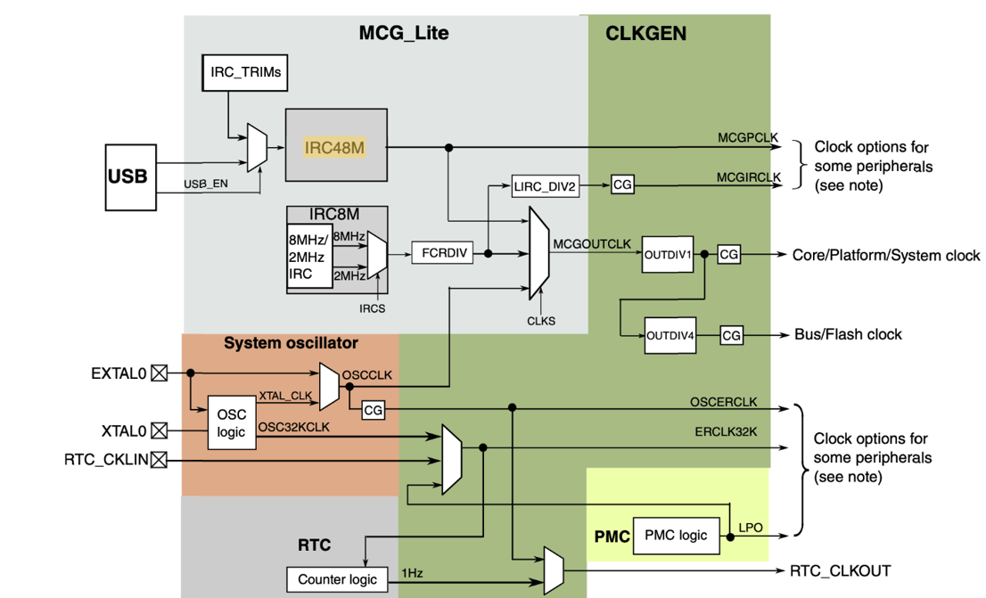
Clock Source Setup
The TPMs can be driven by several internal and external clock sources.

Slide 8
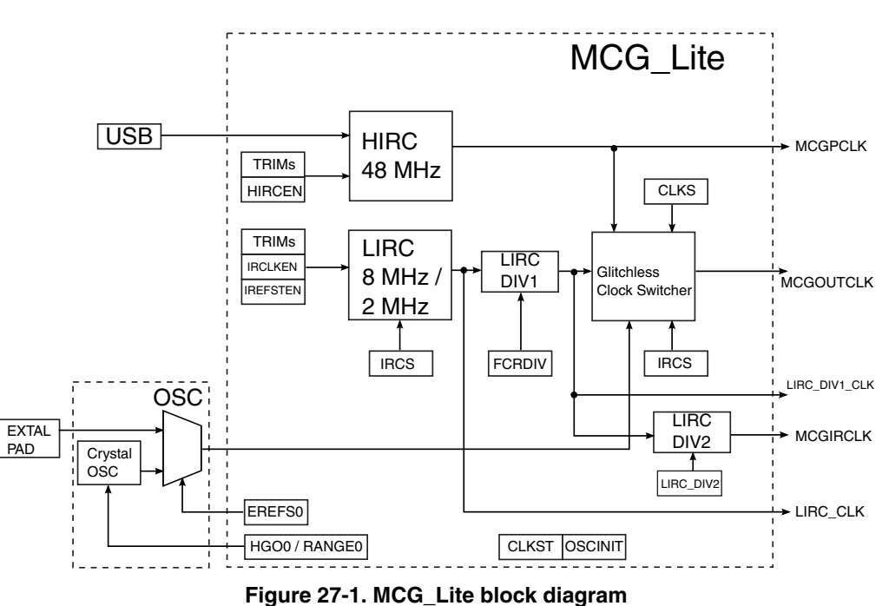
Clock Source Setup
We will use the Multipurpose Clock Generator Lite (MCG-Lite) to drive the TPMs.
  Features a high frequency internal reference clock (HIRC) of 48 MHz and low frequency internal reference clock (LIRC) source of 8 MHz or 2 MHz.

Slide 9
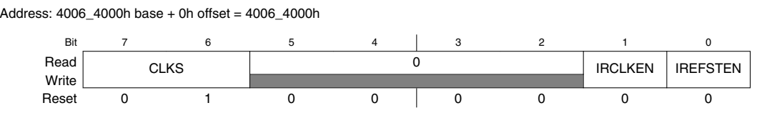
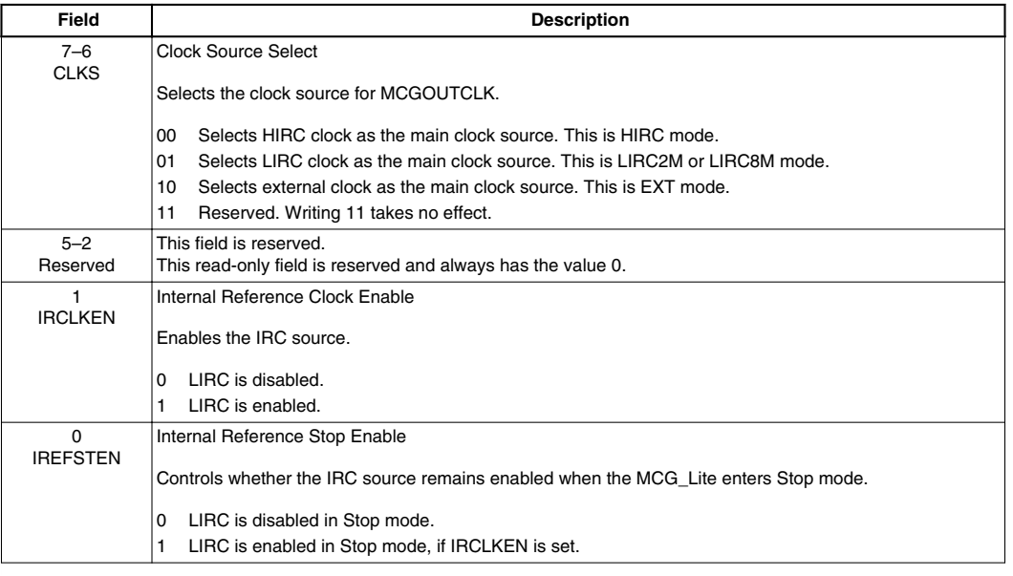
Choosing the MCG Clock Source
The MCG Control Register 1 (MCG_C1) lets you choose the clock source in the CLKS bits:

Slide 10
Choosing the MCG Clock Source
Which clock source you choose depends on the time interval you wish to program.
  In our example we will generate an interrupt once per second.
  Using a 48MHz clock will require a very large prescalar, so we will use the 8 MHz clock instead.
This means that we will choose LIRC as the main clock source: CLKS = 0b01.
We also need to set IRCLKEN to 1 to enable the low frequency internal reference clock.

Slide 11
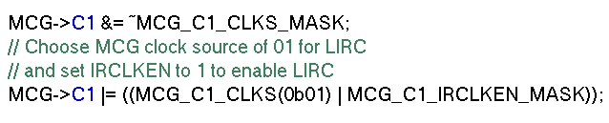

Choosing the MCG Clock Source
  MCG Control Register 2 (MCG_C2) lets you choose either the 8 MHz or 2 MHz clocks by setting the IRCS (internal reference clock select) bit to 0 (2 MHz) or 1 (8 MHz).

Slide 12
Choosing the MCG Clock Source
MCG lets you further divide the clock frequency two more times (circled) to generate the final output frequency at MCGIRCLK

Slide 13
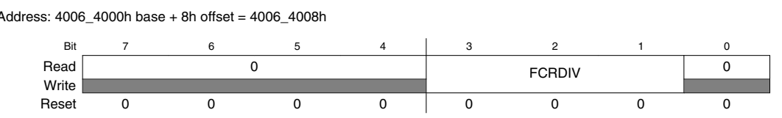
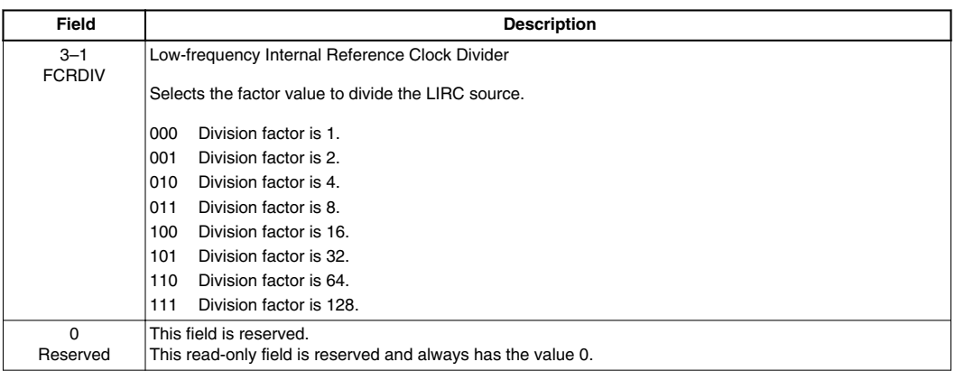
Choosing the MCG Clock Source
We do this through the FRCDIV bits of the MCG Status and Control Register (MCG_SC) and LIRC_DIV2 bits of the MCG Miscellaneous Control Register (MCG_MC)

Slide 14
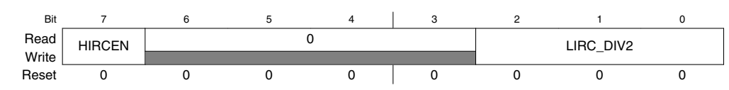
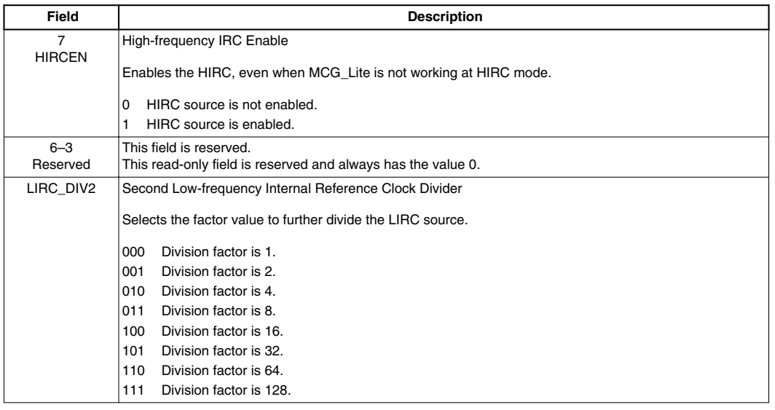
Choosing the MCG Clock Source

Slide 15
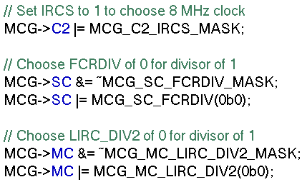
Choosing the MCG Clock Source
Since we want to keep the 8 MHz frequency, we choose divisors of 1 for FCRDIV and LIRC_DIV2:

Slide 16
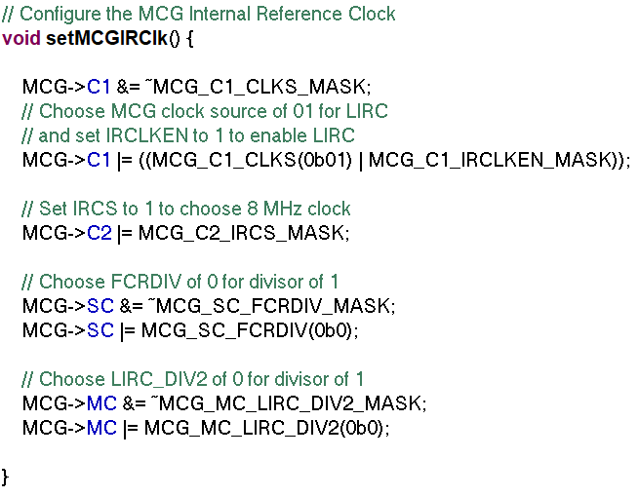
Clock Source Setup Full Code

Slide 17
Tpm setup
Lab Lecture 4 – Timer Programming

Slide 18
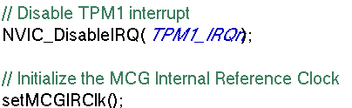
Preliminary setup
It is always good practice to disable interrupts while setting up a timer.
  We are going to use TPM1, so we disable TPM1_IRQn
  We also call setMCGIRClk which sets up the MCG internal reference clock, as shown in the previous section:

Slide 19
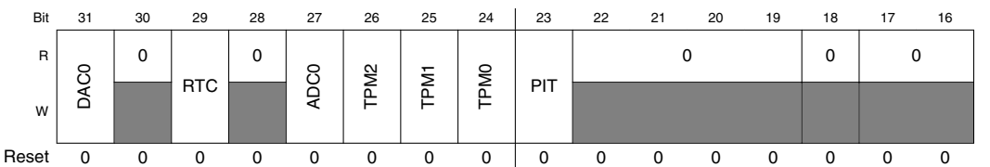

TPM Clock Gating
We will now set up the TPM. We begin first by turning on the clocking to the correct TPM in SIM_SCGC6:
  In our example we will use TPM1, so we set the TPM1 bit to 1.

Slide 20
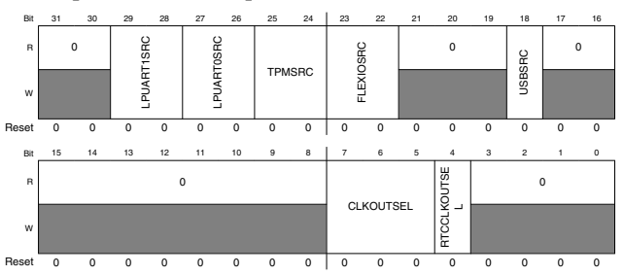
TPM Clock Selection
We select which clock we want to use for the TPM through the TPMSRC bits in the System Options Register 2 (SIM_SOPT2).
  SIM_SOPT2 also controls the clock selection for the USB, low power UART, etc.

Slide 21
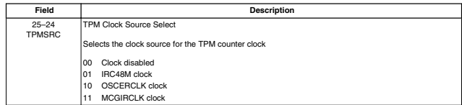
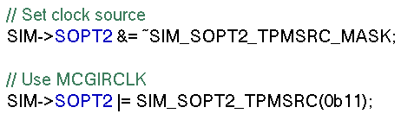
TPM Clock Selection
Since we have set up the MCG Internal Reference Clock (MCGIRCLK), we will use that (0b11):

Slide 22
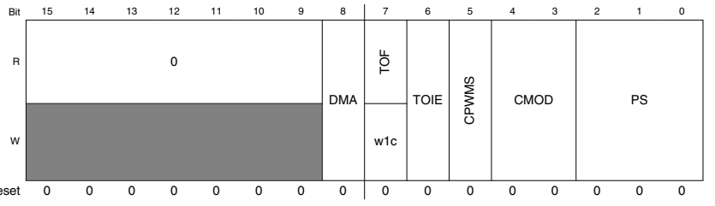
TPM Core Setup
We can now begin setting up the TPM itself.
  We begin by turning off the TPM by setting CMOD (counter mode) to 0.
  We clear the prescalar bits PS.
  Both of these are in the TPM Status and Control Register TPMx_SC:

Slide 23
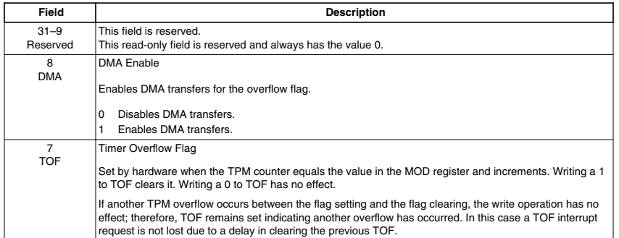
TPM Core Setup

Slide 24
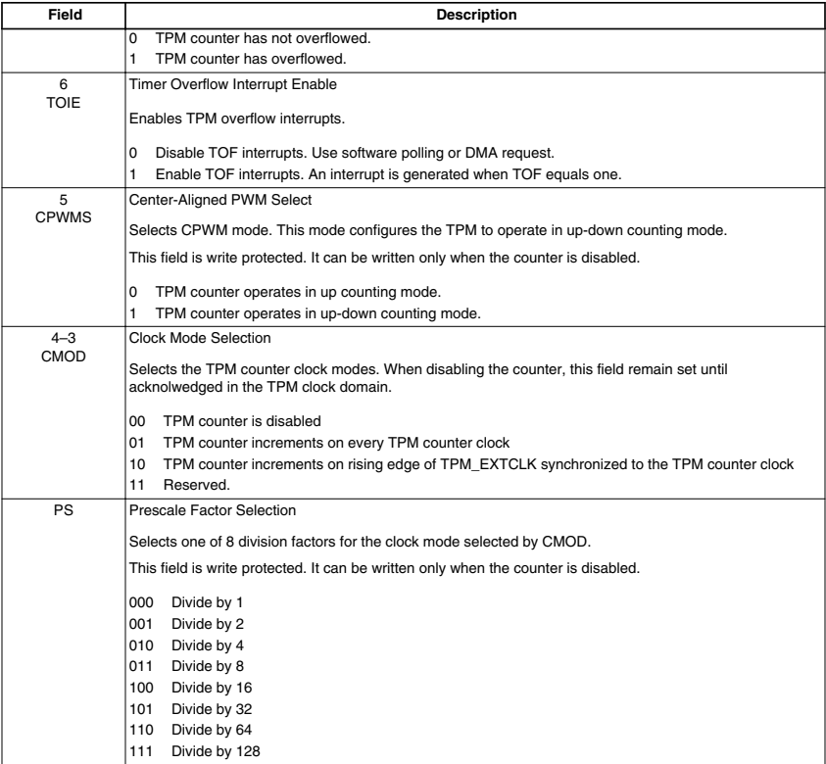
TPM Core Setup

Slide 25
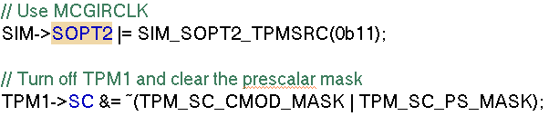
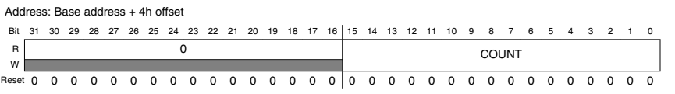

TPM Core Setup
We turn off the timer and clear the prescalar:
The TPM maintains its count using the TPMx_CNT register, which we initialize to 0.

Slide 26
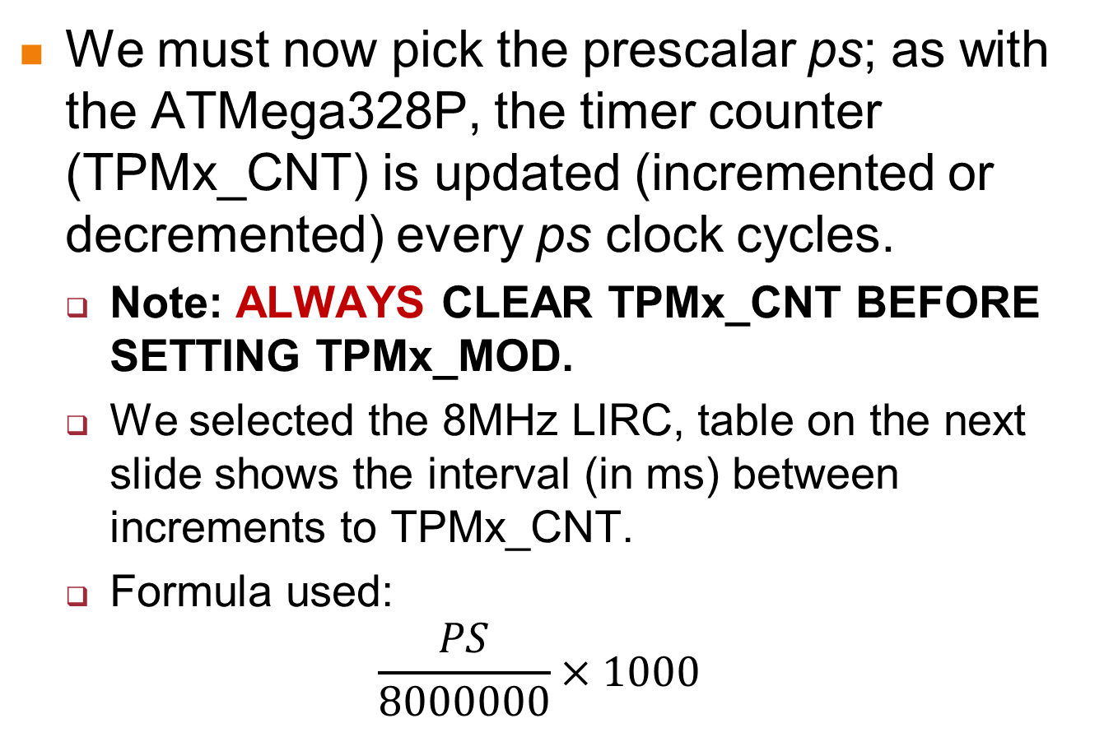
TPM Prescalar and Modulo Selection
We must now pick the prescalar ps; as with the ATMega328P, the timer counter (TPMx_CNT) is updated (incremented or decremented) every ps clock cycles.
  Note: ALWAYS CLEAR TPMx_CNT BEFORE SETTING TPMx_MOD.
  We selected the 8MHz LIRC, table on the next slide shows the interval (in ms) between increments to TPMx_CNT.
  Formula used:
  $$\frac{PS}{8000000}×1000$$

Slide 27
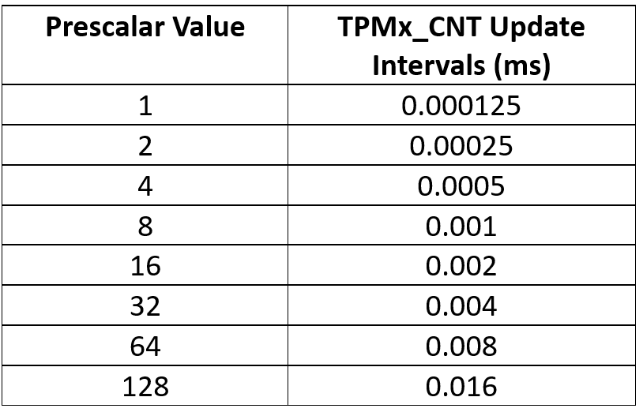
TPM Prescalar and Modulo Selection

Slide 28
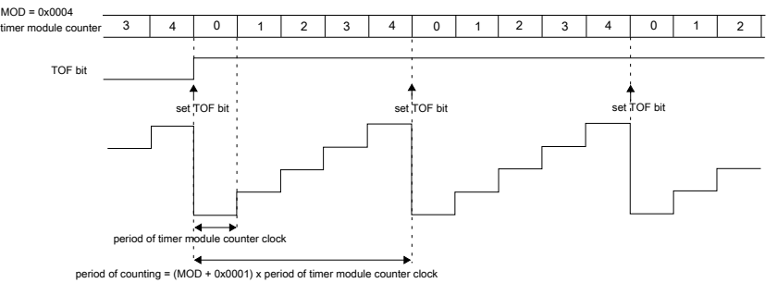
TPM Prescalar and Modulo Selection
The selection of the prescalar is related to the selection of the modulo (TPMx_MOD) value.
  When TPMx_CNT reaches the value in TPMx_MOD, the timer overflow flag (TOF) is set, and if the timer overflow interrupt is enabled (through the TOIE bit in TPMx_SC). TPMx_CNT is cleared if in up-counting mode.

Slide 29
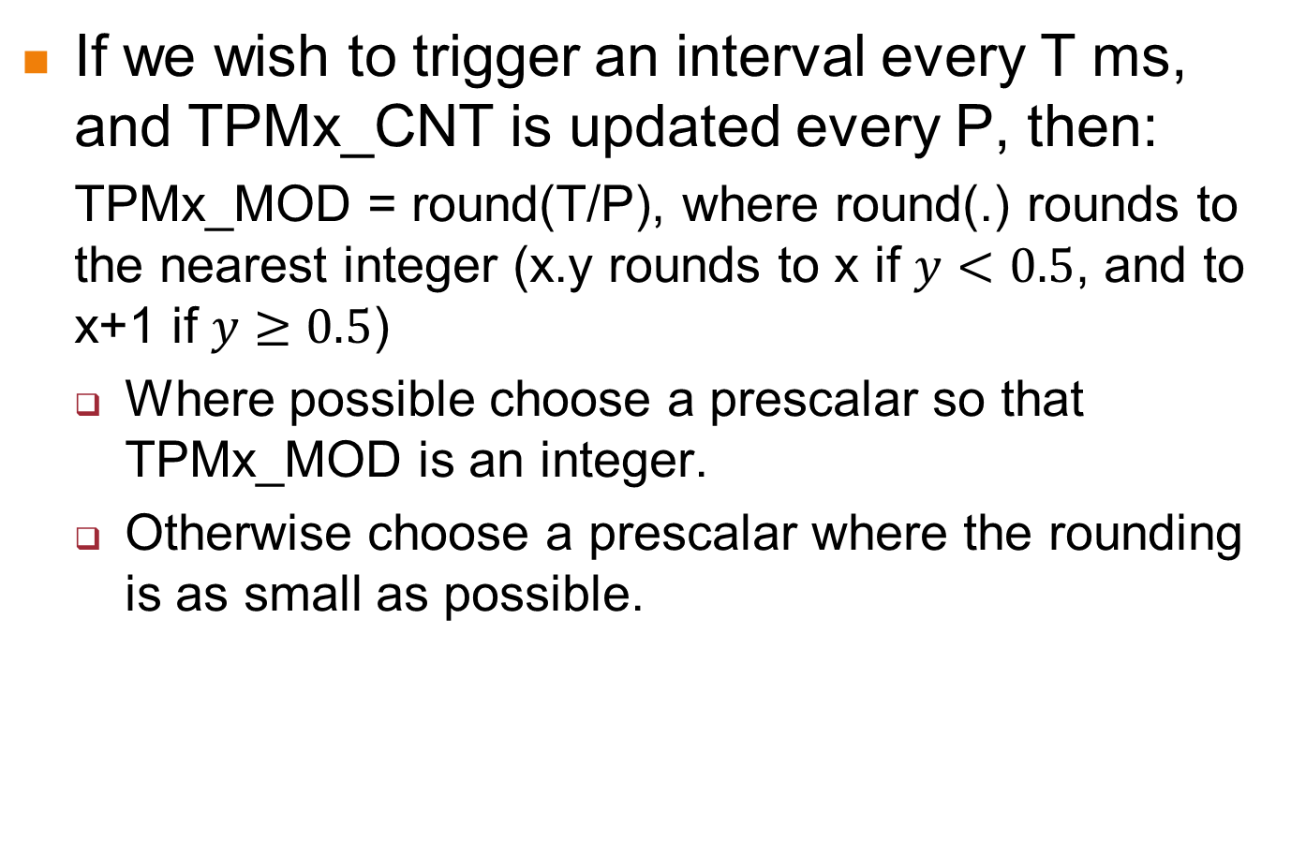
TPM Prescalar and Modulo Selection
If we wish to trigger an interval every T ms, and TPMx_CNT is updated every P, then:
  TPMx_MOD = round(T/P), where round(.) rounds to the nearest integer (x.y rounds to x if $y<0.5$, and to x+1 if $y≥0.5$)
  Where possible choose a prescalar so that TPMx_MOD is an integer.
  Otherwise choose a prescalar where the rounding is as small as possible.

Slide 30
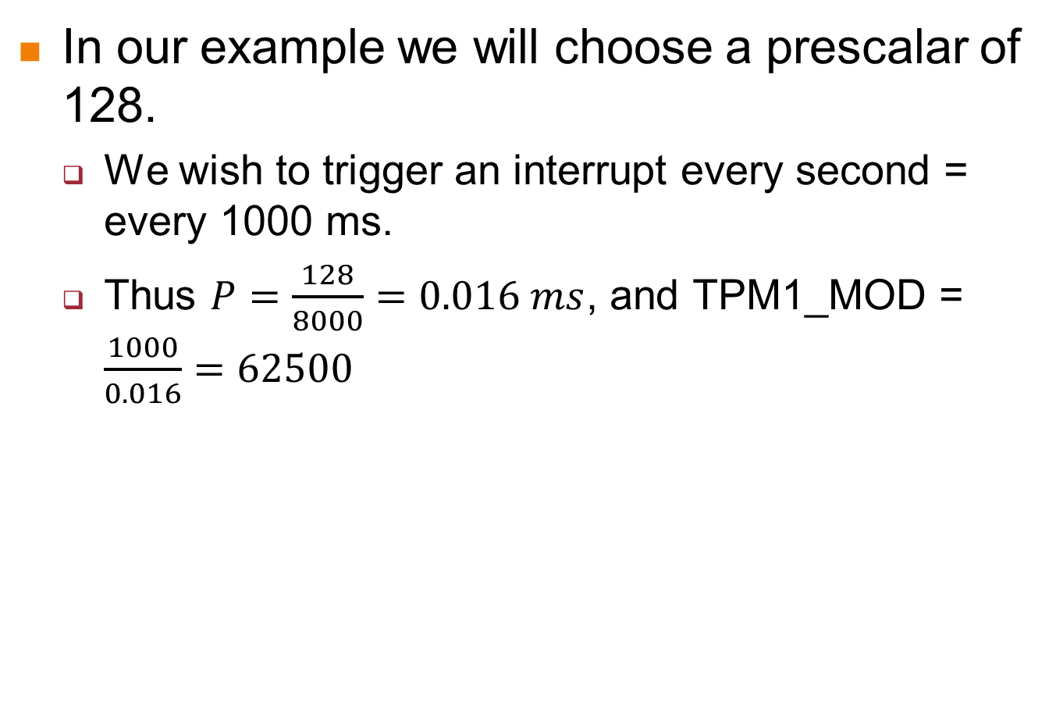
TPM Prescalar and Modulo Selection
In our example we will choose a prescalar of 128.
  We wish to trigger an interrupt every second = every 1000 ms.
  Thus $P=\frac{128}{8000}=0.016 ms$, and TPM1_MOD = $\frac{1000}{0.016}=62500$

Slide 31
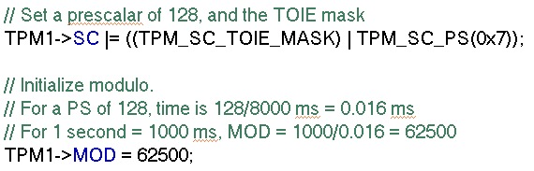
TPM Prescalar and Modulo Selection
So:
  We set PS in TPMx_SC to 7.
  We also set the TOIE bit to 1.
  We set the modulo to 62500

Slide 32
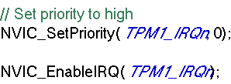
Setting Interrupt Priority and Enabling
Finally we set the interrupt priority and enable the TPM_IRQn interrupt.
Full TPM setup code is on the next slide.

Slide 33
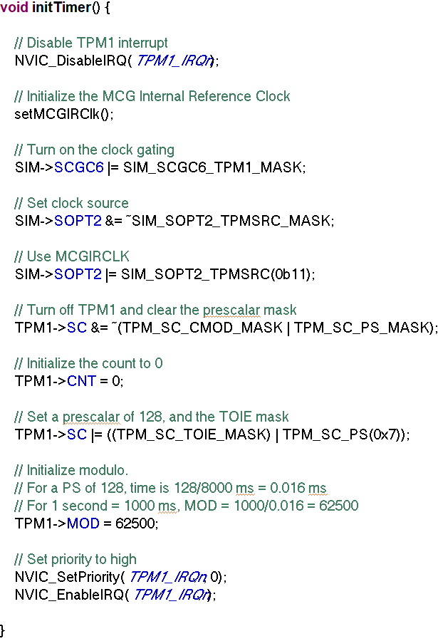
Full TPM Setup Code

Slide 34
Writing the ISR
The various modules in the MCXC444 are each given only a single ISR vector.
  In the case of TPMx, it will be TPMx_IRQn (i.e. TPM0_IRQn, TPM1_IRQn, TPM2_IRQn).
  The corresponding ISRs are called TPMx_IRQHandler.
This means that an ISR can be triggered for various reasons.
  For TPMx, we need to check the TPMx_STATUS register for the reason.

Slide 35
Writing the ISR
The various modules in the MCXC444 are each given only a single ISR vector.
  In the case of TPMx, it will be TPMx_IRQn (i.e. TPM0_IRQn, TPM1_IRQn, TPM2_IRQn).
  The corresponding ISRs are called TPMx_IRQHandler.
This means that an ISR can be triggered for various reasons.
  For TPMx, we need to check the TPMx_STATUS register for the reason.

Slide 36
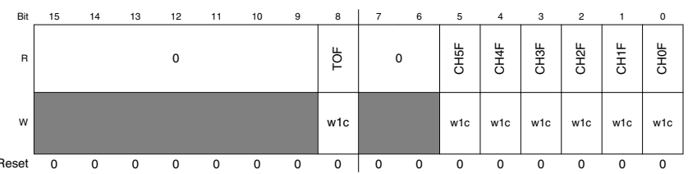
Writing the ISR
We are only interested in the TOF (timer overflow flag) in TPMx_STATUS:
  If TOF=1, then the timer has overflowed and the period we want has passed.
  Write a 1 to TOF to clear it.

Slide 37
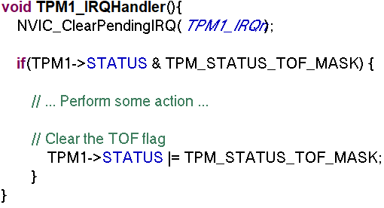
Writing the ISR

Slide 38

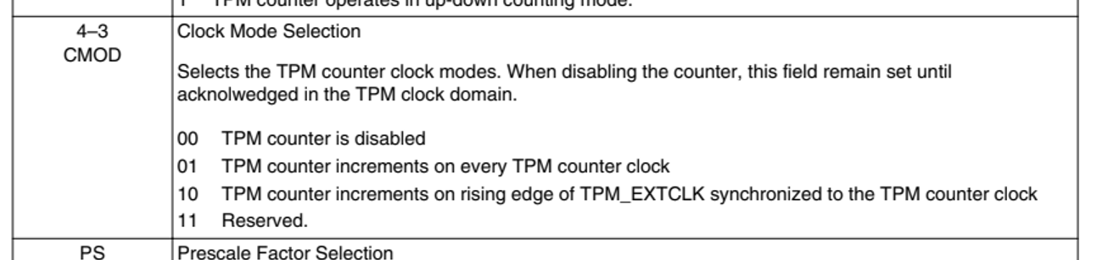
Starting the Timer
We finally start the timer by setting the CMOD bits in TPMx_SC to 0b01:

Slide 39
Conclusion
This lecture shows how to set up the Timer/PWM Module (TPM) to trigger an interrupt at fixed intervals.
In the next lecture we will see how to use the TPM to generate PWM signals.

